Slide 1
Business Proposals& graphics

Slide 2
Business proposal
A proposal is an offer by one party to provide product or service to another party in exchange for money.
Essentially, business proposals are similar to sales documents in the sense that they include an overview of how the business can help the client, a value proposition, scope of work, pricing estimates, expected completion dates, and project costs etc.

Slide 3
Purposes of proposals
Proposals have varied purposes with a wide or narrow scope. Few of the examples are :
To conduct a research before developing an plastic mold factory in foreign country.
Opening an overseas office.
To survey areas for possible water resources.
To construct parking slots, buildings, bridges, highways.

Slide 4
Types
The two basic types of proposals are :
Sales proposals: They sent out to the potential clients or customers. Sales proposals rarely duplicate one another in either structure or style. They are often quite different, creative in directions.
Research proposals: are usually academic in nature & mostly solicited.

Slide 5
Importance of proposals
Proposals, like reports are valuable records of information in an organization.
They act as an index of company’s progress or growth.
Successful proposals gets financial returns to the organization.
They attempt to win contracts for the co. undertaking the project.
Proposal writing enhances the power of estimation, judgment & discrimination in the writer.

Slide 6
Characteristics
Keep in view customer’s convenience, financial gain,& prestige.
Demonstrate to appropriate decision makers that their needs would be met with.
Be more creative than other form of professional writing
Anticipate any possible reasons for rejection & provide suggestions for overcoming them.
Include summary, objective, description of the problem, methodology& cost estimation.
Follow meticulously the requirements of the receipient/organisation.

Slide 7
Structure
1.Prefatory parts:
Title page
Letter of transmittal
Draft contract
Table of contents
List of tables/figures
Executive summary
2. Body of proposals:
Introduction
-Problem
-Need
-Background
-Objective /purpose
-Scope & limitations
-Methods & sources
Technical procedures
procedures
Plan of attack
.Managerial procedures
-Sequence of activities
-Equipments, facilities
-Cost estimate
-Conclusion
3.. Supplementary parts:
Appendices
References

Slide 8
Graphical representation in business writing
Why does your business proposal need graphics?
Their role in your business proposal boils down to the following:
a) Make your document less daunting to consume by making it easy and attractive to read.
b) Convey your message instantly – one look and the prospect "gets" what you’re saying.
c) Clarify difficult concepts about your solution and make information more digestible
Will your reader find your work proposal interesting if you don’t find it interesting yourself?
The answer probably lies somewhere on the scale of "no way" to "less likely." And the solution, you ask? Visually appealing graphics in your business proposal.
Compelling graphics in your document can quickly take it from zero to hero – communicating your message effectively and encouraging the reader to read. In the long haul: great visuals that amplify your message increase your odds of success.

Slide 9

How to use graphics in business proposal
Explain your idea or point, for instance your workflow with a flowchart.

Slide 10

Show your product or service in action.

Slide 11
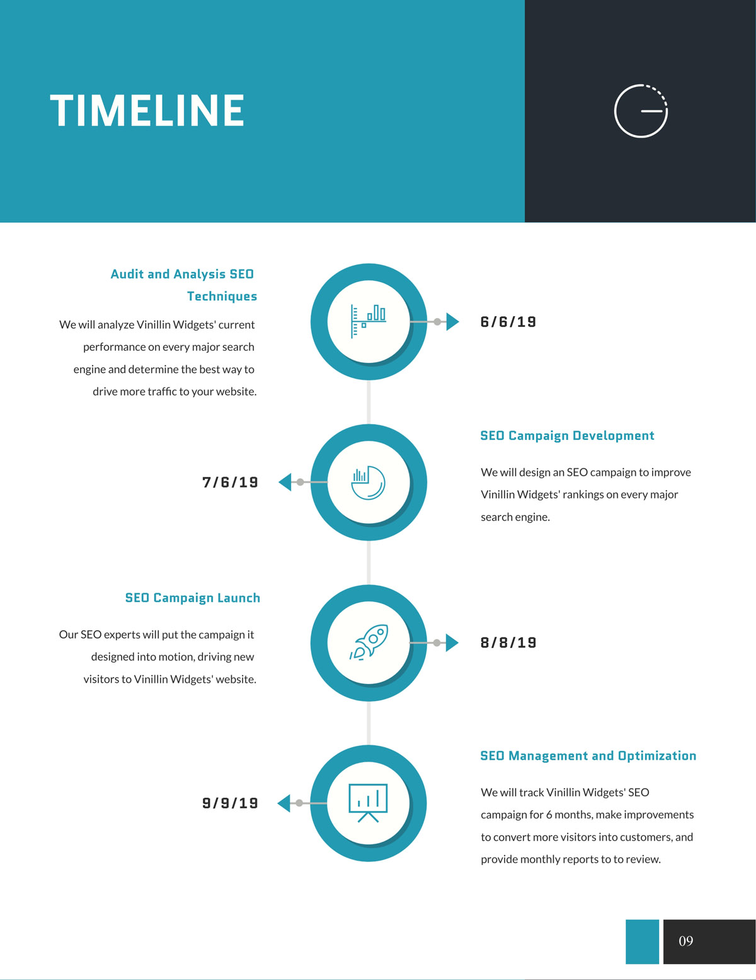
Provide a timeline

Slide 12
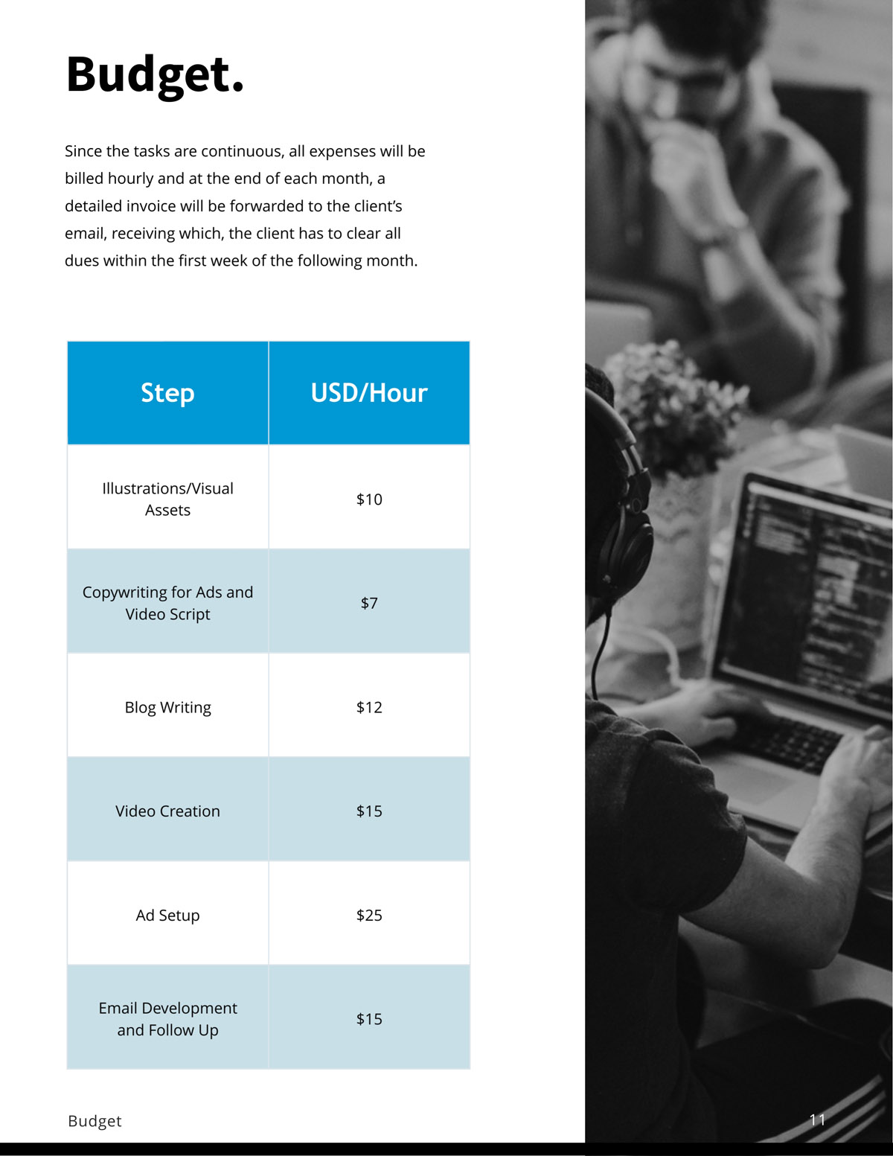
Make pricing and other complex sections easy to understand.
Most readers jump straight to the pricing section after reading the intro.
You’ve got to make it understandable at a glance.

Slide 13
Share social proof in a visually appealing design.
Most people find it hard to read through social proof that looks like a pile of mess. They wouldn’t read the praise you desperately want them to if you don’t present it to them in an appealing, clutter-free manner.

Slide 14
Rule of Thumb Before Adding Graphics
Only add graphics to supplement your message.
when text is paired with visuals, it is 323% more likely to encourage viewers to follow instructions provided than when text is at work only. But don’t overdo.
Make sure your graphics are consistent.
This means your design needs to have the same elements including a uniform color scheme from the landing page for your service to finalizing your business proposal. This will help your visitors get familiar with your branding, leaving a crisp and memorable impression.

Slide 15
Types of graphics
Charts and Graphs
Illustrations
Images
Tables
Info graphics
Icons

